Slide 1
Economic Analysis in Relation to Australia’s Population
James Le Kathleen Lopokoiyit
Radhika Alapati Dante Company

Slide 2

introduction
The Outlook for the Australian Economy is changing and being driven by Covid-19 pandemic.
The economic growth is forecast to be slower and inflation higher.
We have looked at how the changes in Population has impacted the Economic Growth over a 10 Year Period.
For the World, over the period of 1990-2015, the correlation between population growth and real GDP per capita, based on the World Bank Report 2017.

Slide 3

Objectives of the Study
To explore key aspects of the changes in Australian GDP in the past 10 years.
To compare changes in the Australian growth to that of the World Population.
Does the population growth impact the Economic growth of Australia.
To find out if the Birth and Death Rate have had an impact on the natural increase in population
To describe how migration has impacted changes affected the population growth in Australia.
To show projected changes in the Australian Population growth with changes in the migrated populations.
To compare the World GDP per capita to Australia’s GDP

Slide 4
Hypothesis
H0: Changes in the Australian Economy have not affected the Population.
H1: Changes in the Australian Economy have had an impact on the Population.
H0: There is no Correlation between GDP per Capita and the Population Growth.
H1: There is a Positive Correlation between GDP per Capita and the Population Growth
H0: Immigration has not had a Significant Impact on Australia’s and the World’s Economy
H1: Immigration has had a Significant Impact on Australia’s and the World’s Economy

Slide 5
Questions
Is there a Correlation between the GDP per Capita and the Population Growth?
Has Immigration played a Significant Impact on Australia’s and the World’s Economy?
dante

Slide 6
WBGAPI
Pythonic access to the World Bank’s Data API.
Australian Economic data are pooled for the period of 2010-2020 from the World Bank API. Key economic indicators are compared against the population changes within the same time period.
dante

Slide 7
Questions and Data
dante

Slide 8
Data Exploration & cleanup
RADHIKA START SLIDE
ABS(Australian Bureau of Statistics) data has been taken for Australia Population, Migration and GP per Capita.
World Bank data has been taken for World Population, GDP
The input data from ABS has some special characters which has been removed to eliminate data processing errors
World Bank data NULL values has been replaced with Zeros to improve data quality and processing

Slide 9
Data analysis
Australia Population vs GDP per Capita Impacted by Immigration
Conclusion Analysis : Australia Population Growth Significantly impacted by Immigration and GDP Per capita growth also follows along with immigration growth.
Australia Natural Growth
Australia Population Growth for last 10 Years including Natural and Immigration Grwoth
Australia GDP Per Capita Growth
Australia vs World GDP Per Capita Growth
Australia Immigration Growth
World GDP Per Capita Growth
Australia Position in Top 10 Immigration Countries in the world
Australia vs World Population Growth
Australia Position in Top 10 Immigration Countries in the world(GDP)

Slide 10
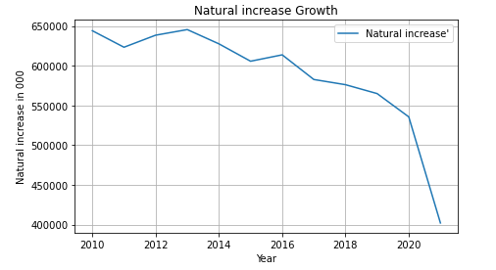
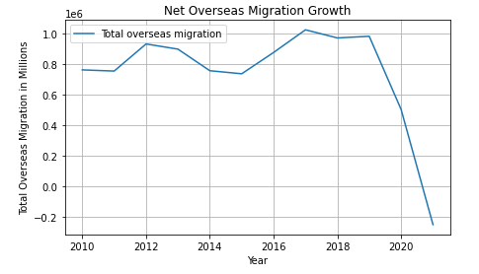
Australia Population Natural Increase and Immigration Growth Rate from 2010 to 2020

Slide 11
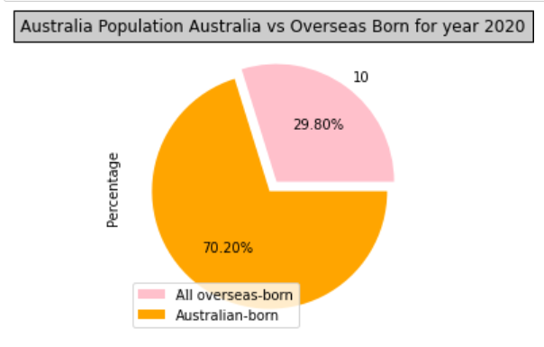
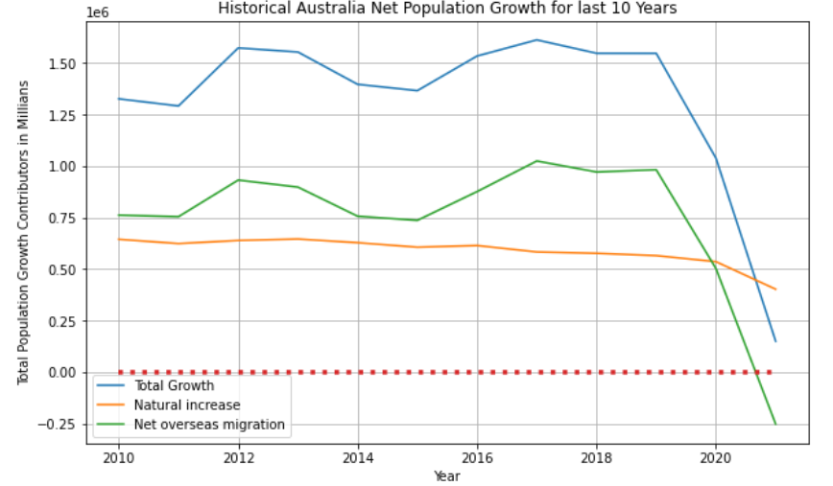
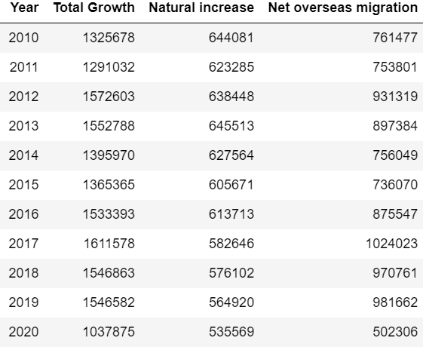
Australia Net Population Growth Rate from 2010-2020 -- Migration Population Contribution in Australia population as of 2020

Slide 12
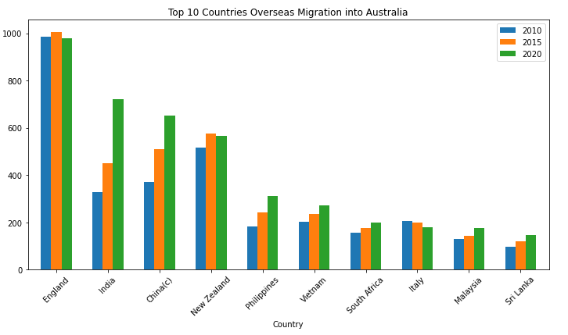
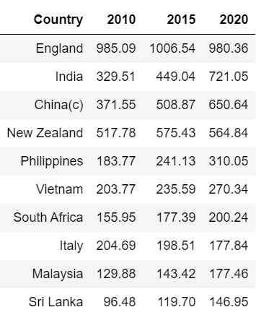
Top 10 Countries Overseas Migration into Australia. 2010, 2015, 2020

Slide 13
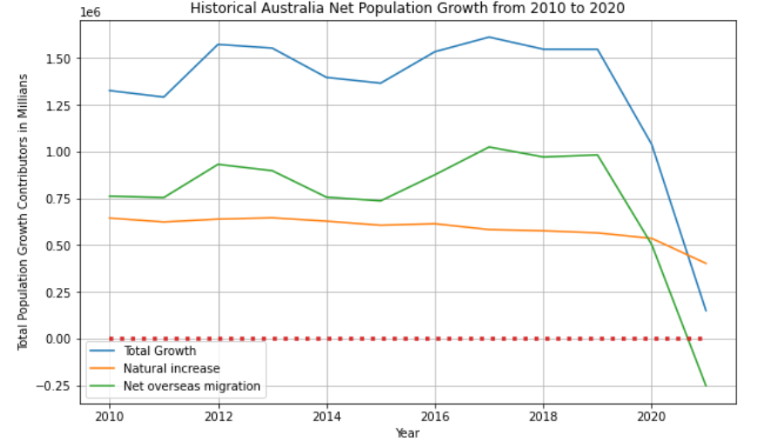
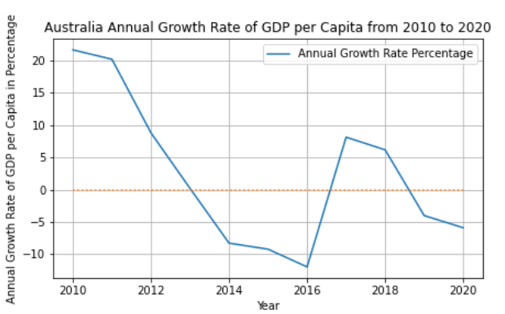
Final Analysis -- Australia Population vs GDP Per Capita Growth from 2010 to 2020

Slide 14
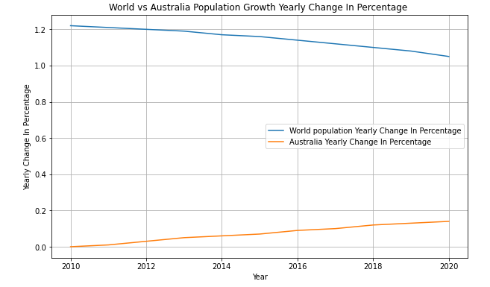
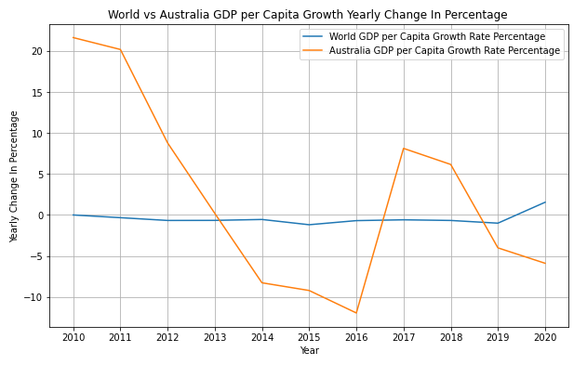
World Population vs Australia Population Growth Rate from 2010 to 2020

Slide 15
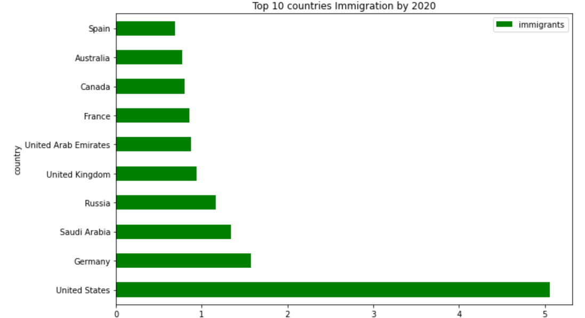
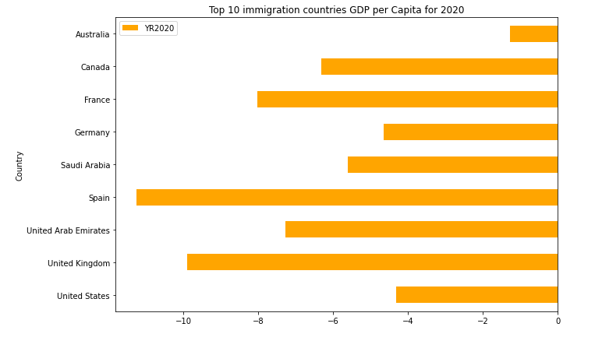
Australia Place in Top 10 Immigration countries based on Immigration Growth and GDP Per capita Growth for 2020
1st Place
9th Position

Slide 16
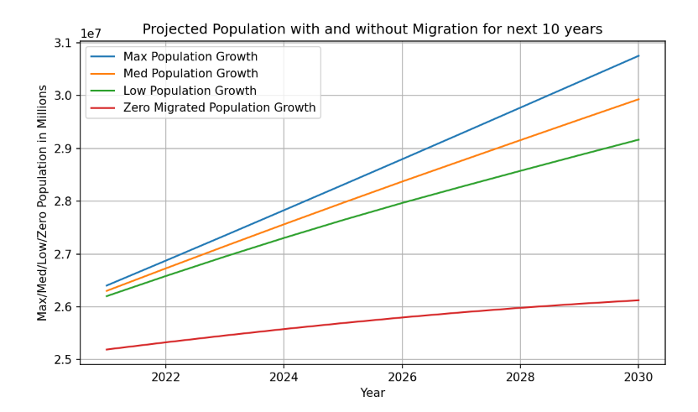
Australia Projected Population with and without Migration for 2020-2030
RADHIKA END SLIDE

Slide 17
Conclusion
kathleen

Slide 18
Post mortem
Discuss your findings. Did you find what you expected to find? If not, why not? What inferences or general conclusions can you draw from your analysis? Discuss any difficulties that arose, and how you dealt with them Discuss any additional questions that came up, but which you didn't have time to answer: What would you research next, if you had two more weeks?
kathleen

Slide 19
Resources
https://www.abs.gov.au/
https://pypi.org/project/wbgapi/

Slide 20

QUEstions

Slide 21
Thank you

